Slide 1
INTRODUCTION
Hello. We are a group of school mates who decided to take part in this project called WINNING THE GOLD. We attend Primary School Antona Aškerca Rimske Toplice. Rimske Toplice is a small town in eastern Slovenia. We are 12 years of age ands we are in class 7.

Slide 2
SPORT IN OUR LIVES
We are Veronika Novaković and Tinkara Repovž . Sport has been and it will always be an important part of our lives. If you take up a sport there will be no limits for you, you’ll meet new people, new friends. Sport helps you to overcome life‘s toughest challanges and furthermore it unites all the countries together. Practising sport is very easy, and you only need to feel it. Playing sports keeps you fit and healthy as well.

Slide 3
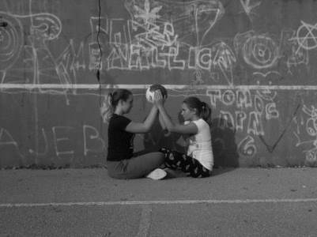
We were thinking a lot before this idea came out. We're not big fans of sport but we do like it. Most of all we like dancing (PLES in Slovene).
It's a kind of sport but a little different. We also like rollerblading (ROLANJE) and swimming (PLAVANJE). When we have P.E at school we like playing dodge ball (MED DVEMA OGNJEMA) and tennis (TENIS).

Slide 4
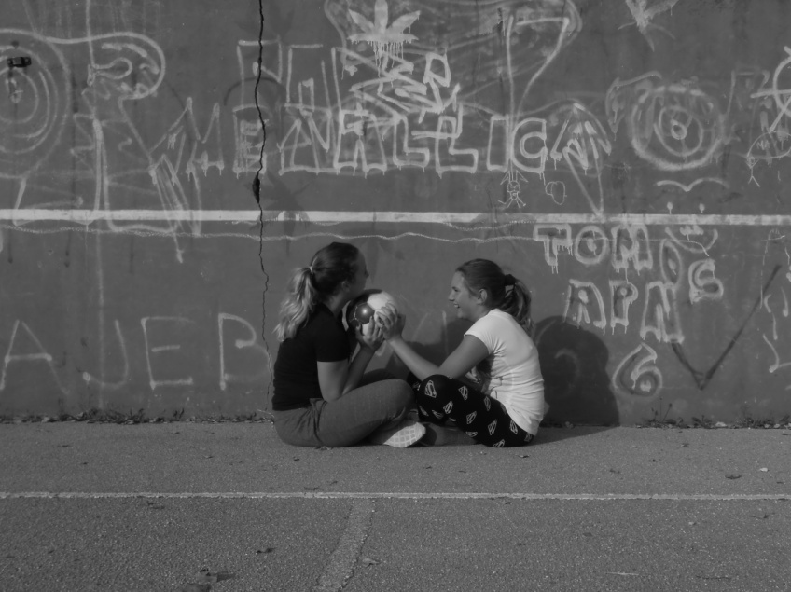
In our free time we play volleyball (ODBOJKA) , basketball (KOŠARKA) and football (NOGOMET) in our own way or we just run around. The pictures were made on the playground next to the school where we spend a lot of time. We run, we play with our friends or we just make the new game and we play it. We have a lot of fun doing sport. It makes us feel powerful and strong. We want to show that sport connects us and make us stronger.

Slide 5
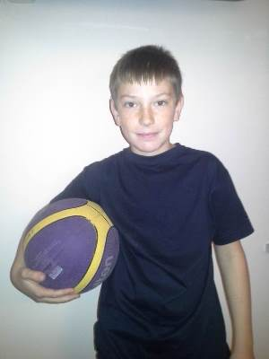
I’m Jošt Bezgovšek. In my free time I play basketball (KOŠARKA). I like it because it is a tim sport.

Slide 6
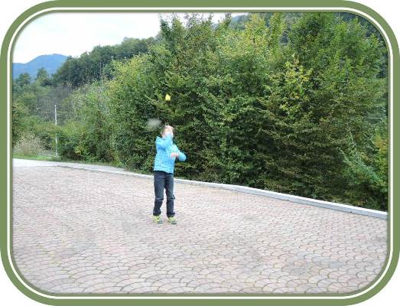
My name is Gašper Zupan. In my free time I go jogging (POČASEN TEK) and cycling
(KOLESARJENJE). I play badminton (BADBINTON) and basketball (KOŠARKA). I Iike badminton because I am good at it.

Slide 7
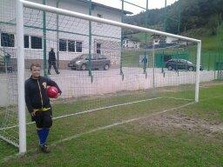
Hi, my name is Urban Tovornik. In my free time I play football (NOGOMET). I play for the football club Pivovarna Laško. I like this sport because it is so fun and easy to play. I also like it becasue it connects a lot of pupils at our school.

Slide 8
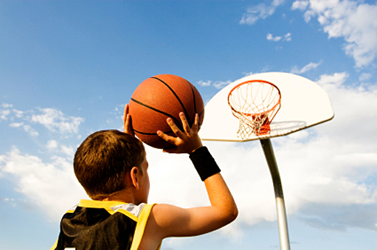
I am Staš Doberšek. In my free time I play basketball (KOŠARKA)and football (NOGOMET). I like these two sports because I have lots of fun playing them.

Slide 9
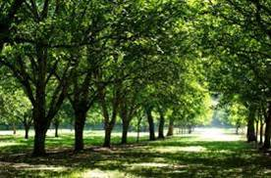
My name is Kristina Starc. In my free time I like climbing trees (PLEZANJE PO DREVESIH).

Slide 10
My name is Žiga Gorenc. In my free time I like playing with my dog, like catching a ball, or just playing different ball games (IGRE Z ŽOGO)with my friends. I enjoy playing online games on my tablet as well.
I like football because it's fun sport, I like basketball too but football is better.
I also like taking my dog for a walk because he is a good boy and I like him, but he can be very sneaky sometimes and he "takes himself" for a walk in the woods or to other houses

Slide 11
